Slide 1

3 B
WORK AND PLAY

Slide 2
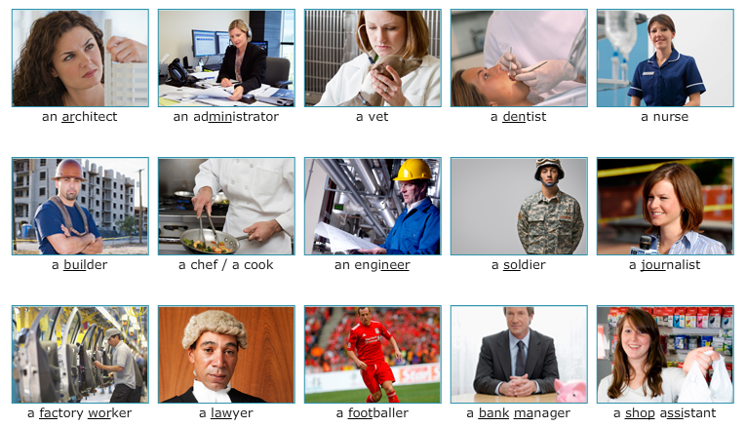
jobs

Slide 3
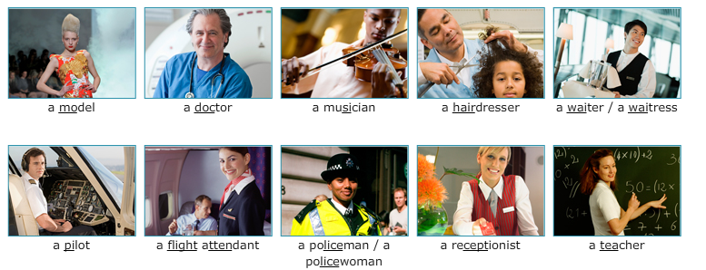
jobs

Slide 4

What do you do? What does she/he do?
Repeat and memorize the posible answers to the question WHAT DO YOU DO?
Remember to use an article before the occupation.

Slide 5
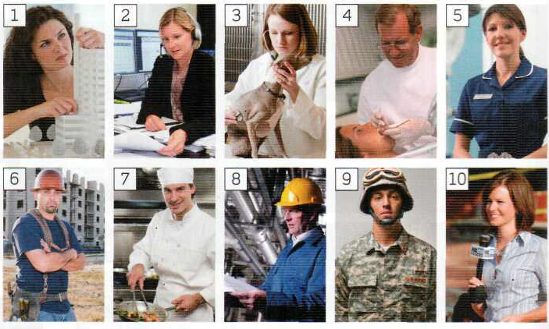
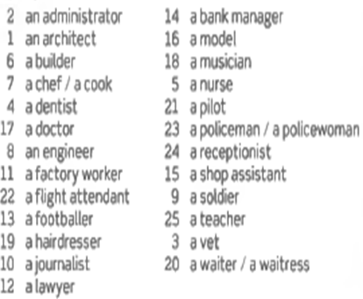
154

Slide 6
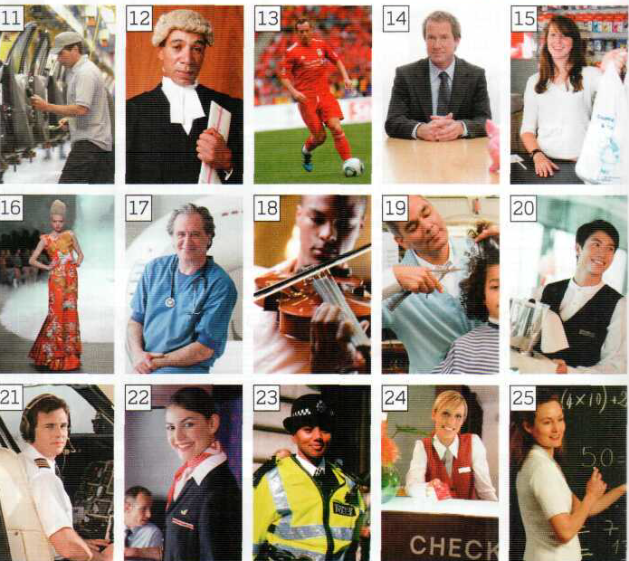
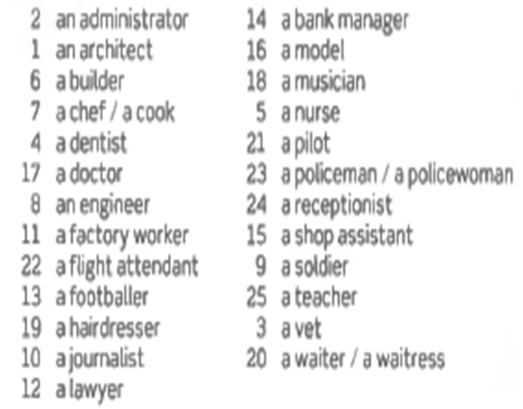
MEMORIZE ALL THE OCCUPATIONS

Slide 7
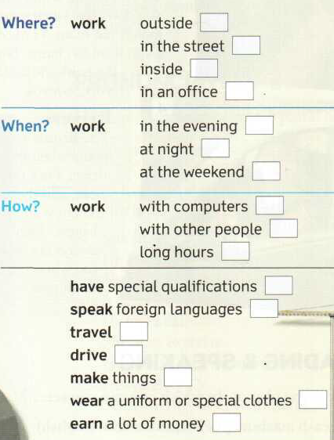




2.10
THE JOBS QUIZ
2.11
The team: David, Kate, Laura
Guest: Wayne
(Tanya is Wayne’s wife)
2.12

Slide 8
(script in Student’s Book on p.116-117) A = announcer, P = presenter, D = David, К = Kate, L = Lorna, W = Wayne
A And now on Radio 4, His job, her job.
P Good evening and welcome again to the jobs quiz, His job, her job. And our team tonight are David, a teacher... / D Hello.
P Kate, who’s unemployed... / К Hi.
P ...and Lorna, who’s a writer... / L Good evening.
P And our first guest tonight is... / W Wayne.
P Hello Wayne. Welcome to the programme. What’s your wife’s name, Wayne? / W Her name’s Tanya.
P Tanya? Nice name. OK, team, you have one minute to ask Wayne questions about his job and then one minute to ask him about Tanya’s
job, starting NOW. Let’s have your first question.
D Hi, Wayne. Do you work in an office? / W No, I don’t.
L Do you work in the evening? / W It depends. Yes, sometimes.
К Do you make things? / W No, I don’t.
L Do you wear a uniform or special clothes? W Yes - 1 wear special clothes.
К Do you drive in your job? W No, I don’t.
L Do you work with other people? W Yes, I do. Ten people.
К Do you have special qualifications? W Qualifications? No, I don’t.
D Do you speak foreign languages? W No, only English.
P You only have time for one more question team...
D Do you earn a lot of money? W Yes, I do.
P Your time's up.

Slide 9
REPEAT, MEMORIZE AND ASK ALL THESE QUESTIONS
Questions to Wayne about his job
1 Do you work in an office?
2 Do you work in the evening?
3 Do you make things?
4 Do you wear a uniform or special clothes?
5 Do you drive in your job?
6 Do you work with other people?
7 Do you have special qualifications?
8 Do you speak foreign languages?
9 Do you earn a lot of money?
in an office?
in the evening?
things?
a uniform…?
drive?
with other people?
special qualifications?
foreign languages?
9. a lot of money?

Slide 10
(script in Student’s Book on p.117]
P Now you have a minute to ask Wayne about Tanya’s job.
К Wayne, does Tanya work outside?
W It depends. Outside and inside.
L Does she work at the weekend?
W Yes, she does.
К Does she work with computers?
W No, she doesn’t.
D Does she wear a uniform or special clothes?
W Yes, she does. She wears special clothes.
К Does she travel?
W Yes, she does. A lot.
L Does she earn a lot of money?
W Yes, she does. A lot.
P That’s time. OK team.

Slide 11
Questions about Tanya’s job (her job)
1 Does Tanya work outside?
2 Does she work at the weekend?
3 Does she work with computers?
4 Does she wear a uniform or special clothes?
5 Does she travel?
6 Does she earn a lot of money?
outside?
at the weekend?
with computers?
a uniform or special clothes?
travel?
a lot of money?

Slide 12
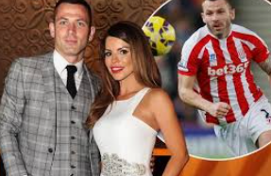
(script in Student’s Book on p.117)
P OK team. So, what's Wayne’s job?
К OK, so you wear special clothes, you work with ten other people, you earn a lot of money... Are you a footballer, Wayne?
W Yes, lam.-
P Very good! And Tanya’s job?
D Let’s see. She works outside and inside. She works at the weekend. She doesn’t work with computers. She wears special clothes, she travels a lot. We think she’s a flight attendant.
P Is that right. Wayne?
W No, that’s wrong. Tanya is a model.

Slide 13
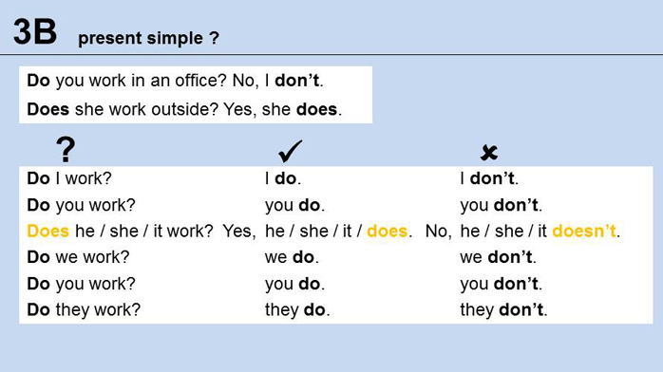
QUESTIONS: Use the auxiliary DO (I, you, we, you, they) and the auxiliary DOES (he, she, it)
NEGATIVE: USE DON´T (I, you, we, you, they) and DOESN´T (he, she, itI)

Slide 14
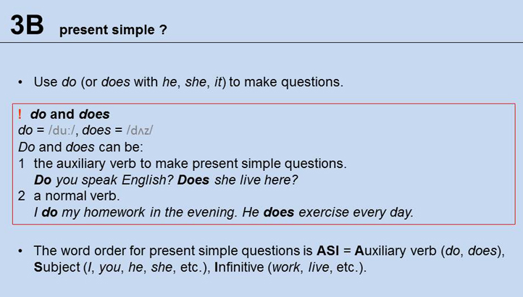

Slide 15
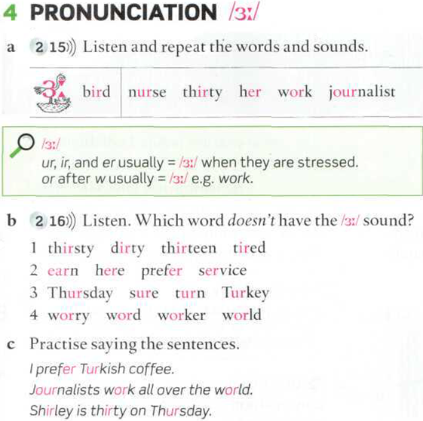
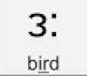
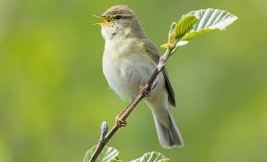
Please repeat these words many times.

Slide 16
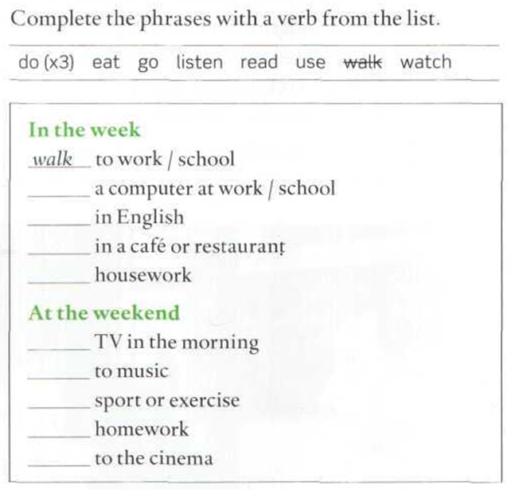
Make all the questions using you
Answer five questions affirmatively
Answer five questions negatively
Make all the questions using he/she
Answer five questions affirmatively
Answer five questions negatively
Example: In the week, do yo walk to university? No, I don´t. I go by bus
Do you use a computer at university? Yes, I do.
Does your best friend (name) read in English? Yes, she does
Does he/she do housework?
No, she doesn´t.
use
read
eat
do
watch
listen
do
do
go

Slide 17
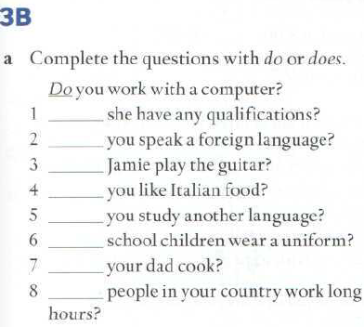
Page 129
Does
Do
Does
Do
Do
Do
Does
Do

Slide 18
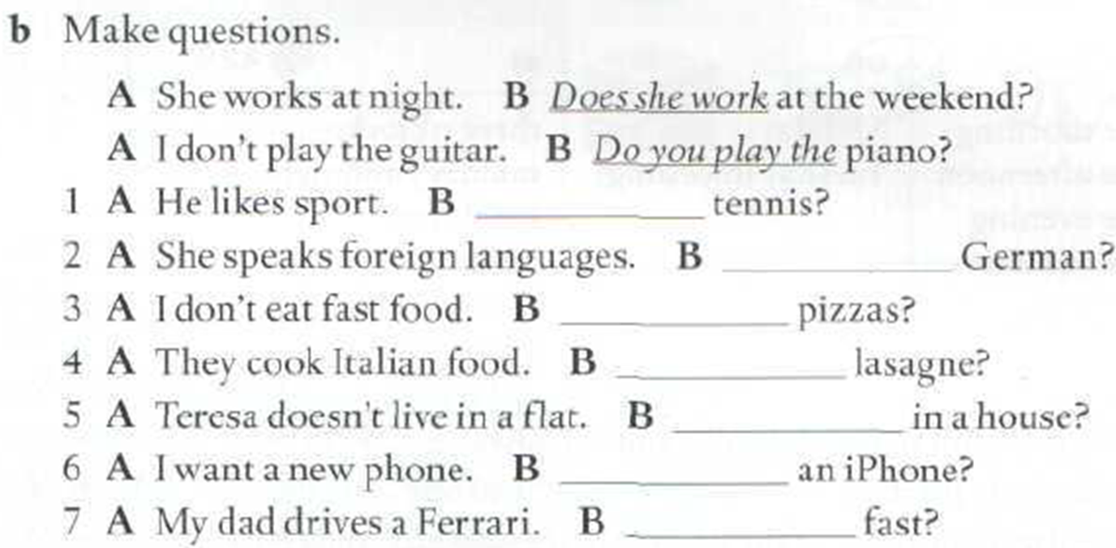
Page 129
Does he play/like
Does she speak
Do you eat
Do they cook
Does she live
Do you want
Does he drive

Slide 19
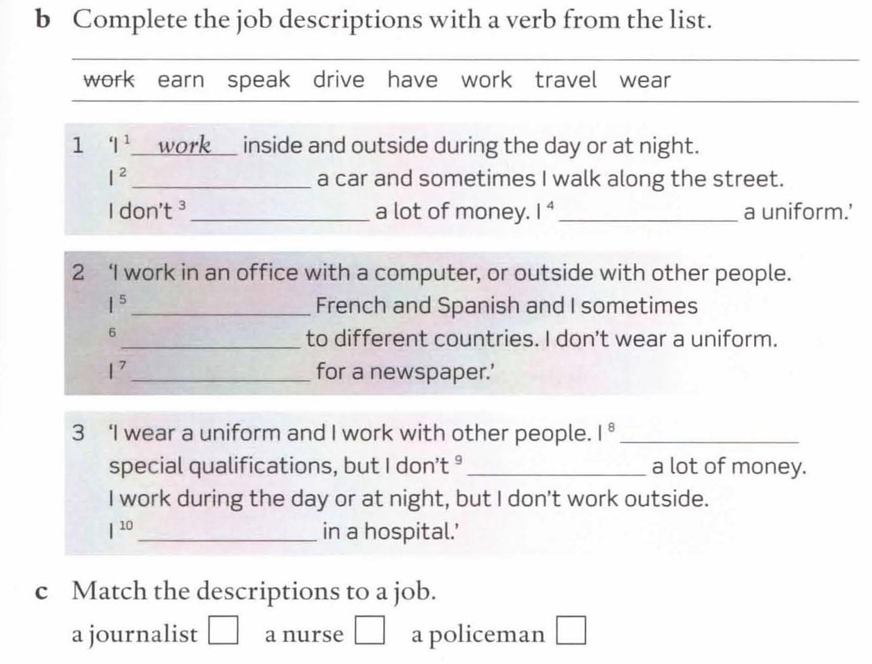
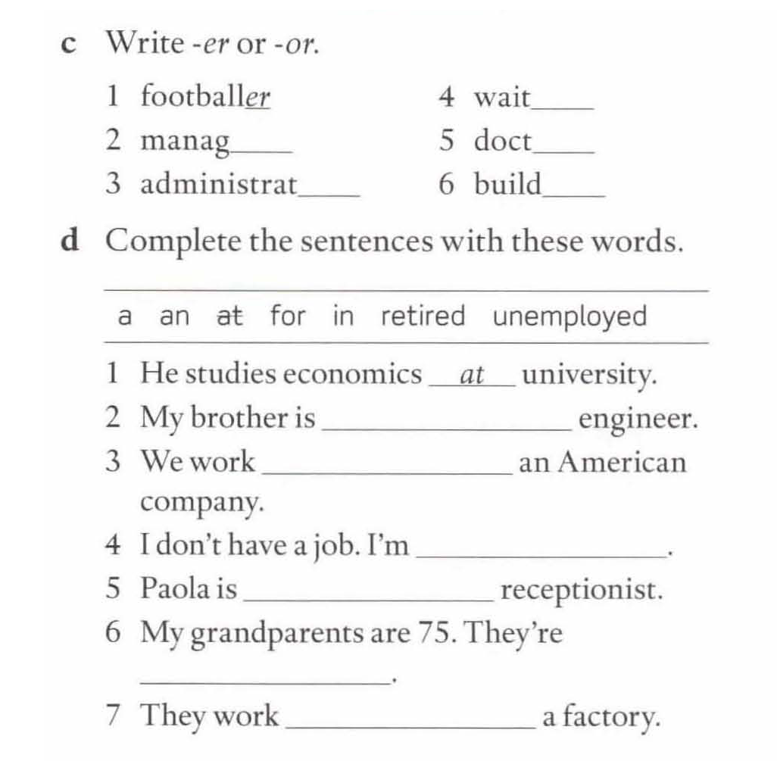
WORKBOOK – PAGE 19
drive
er
earn
wear
er
or
or
er
speak
travel
work
have
an
earn
for
work
unemployed
a
2
3
1
retired
in

Slide 20
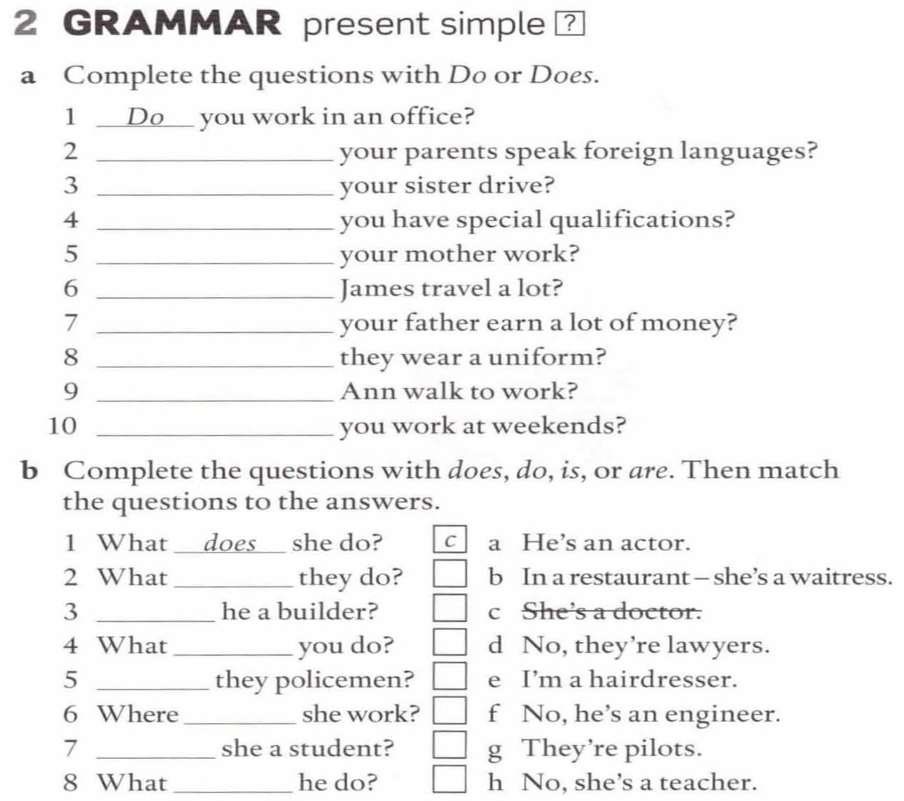
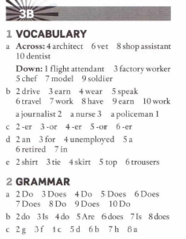
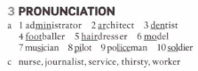
Do
Does
Do
Does
Does
Does
Do
Does
Do
do
Is
do
Are
does
Is
does

Slide 21
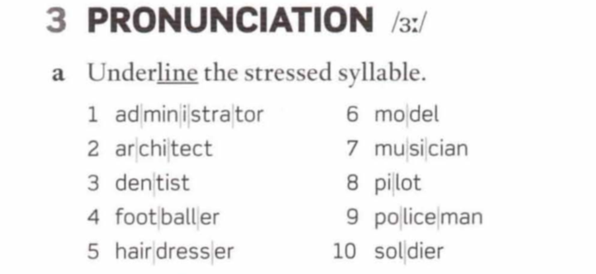
Listen and repeat. Underline the stressed syllable

Slide 22
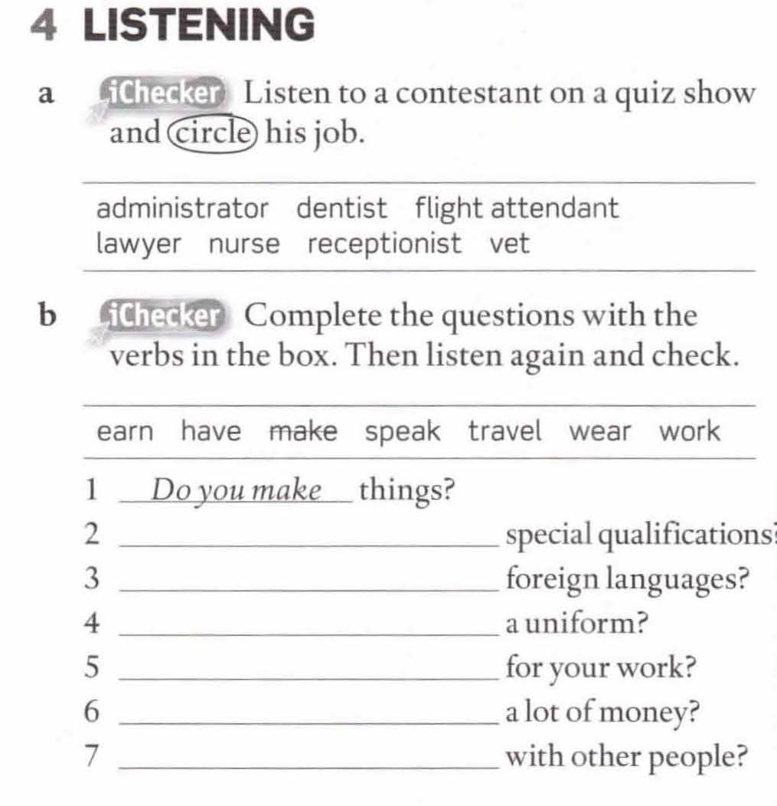
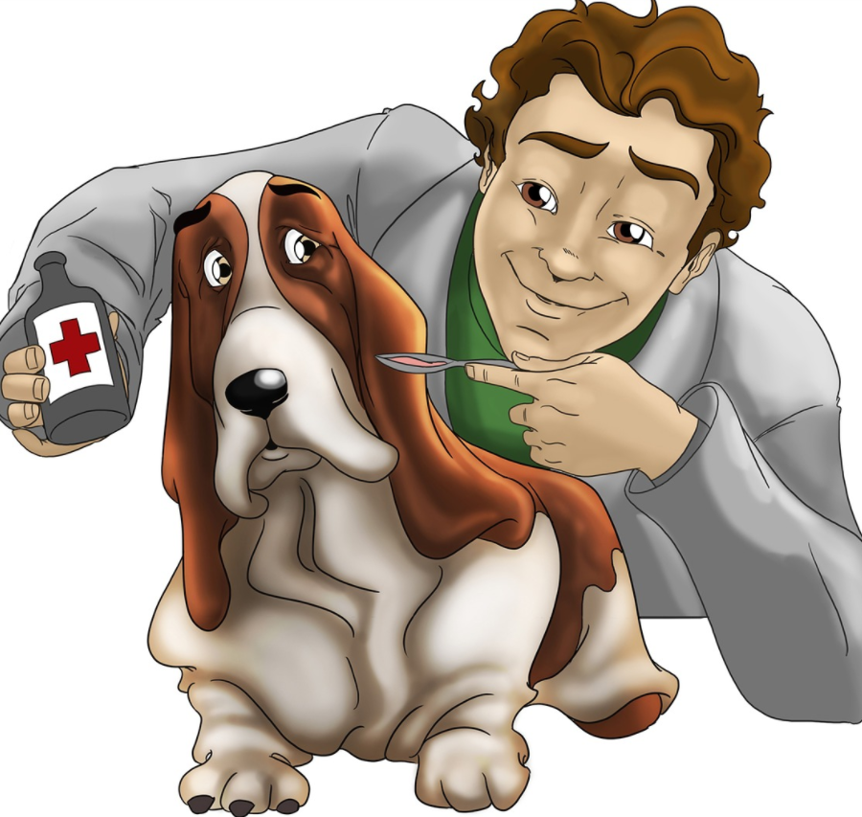
Do you have
Do you speak
Do you wear
Do you travel
Do you earn
Do you work

